Slide 1


Day 2 Flutter Development
Marlon i. tayag

Slide 2
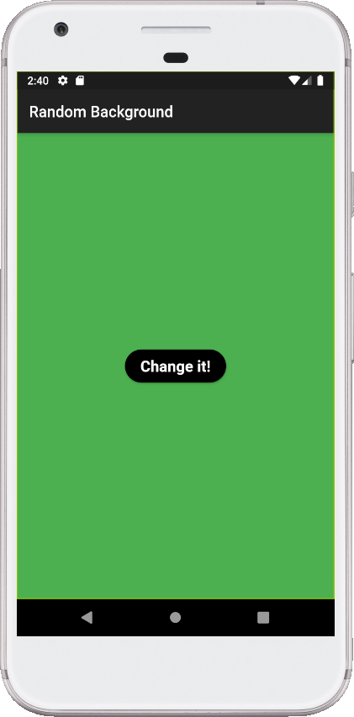
Background Changer App
Create an app that will randomly change its background color when pressing a button
User MaterialApp and Dart:Math library

Slide 3
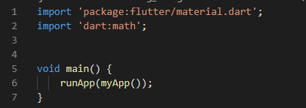
1. Import Library and main()

Slide 4
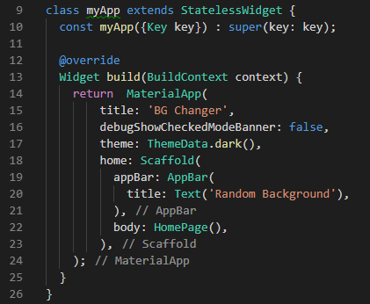
2. Create myApp stateless widget

Slide 5
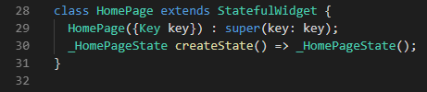
3. Create HomePage stateful widget

Slide 6
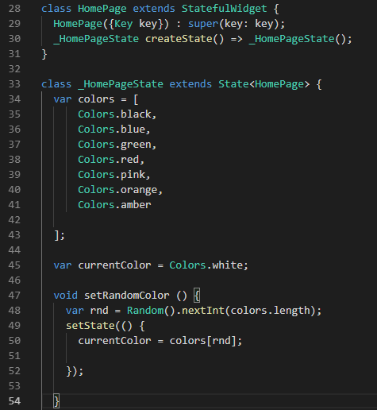
4. Create the _HomePageState state widget

Slide 7
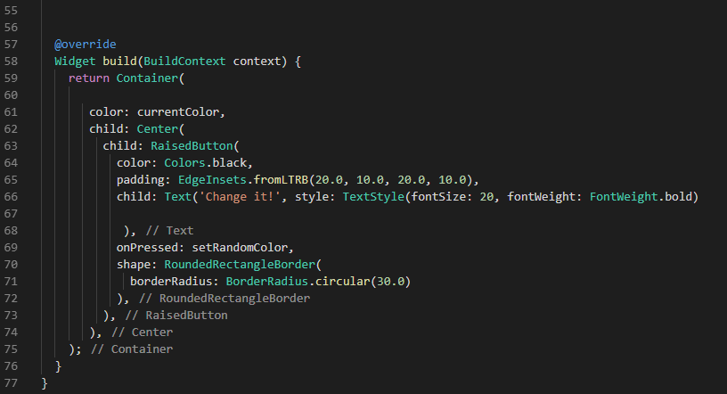
4. Create the _HomePageState state widget (cont’d ..)

Slide 8
Activity Challenge
Automatically change the color of the text based on the background color whenever the user click the button

Slide 9
Background Changer Code

Slide 10
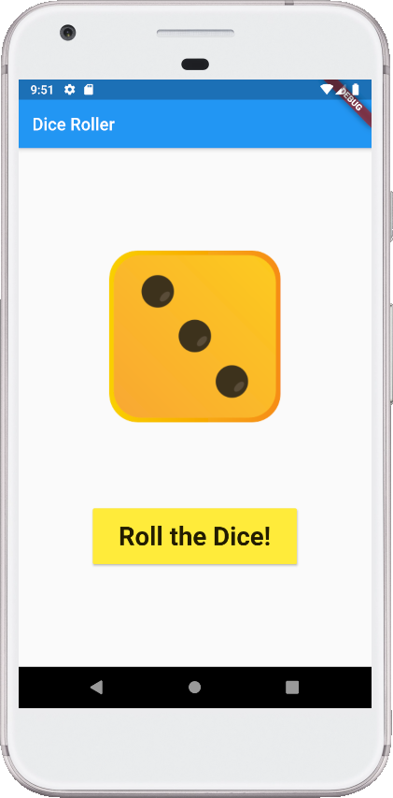
Dice Roller App
Load image to image folder on the project
Edit pubspec.yaml and add images to assets
Create the logic part of the Dice Roller (homepage.dart)
Create the design and layout of Dice Roller (homepage.dart)

Slide 11
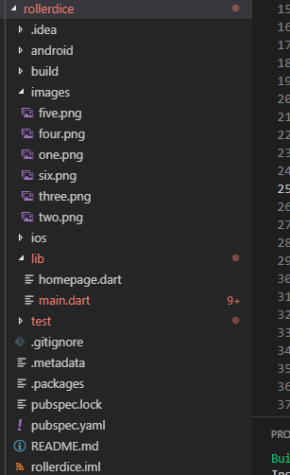
1. Add images
Image folder
Create a folder on the project name image, add all dice image on the folder
Images

Slide 12
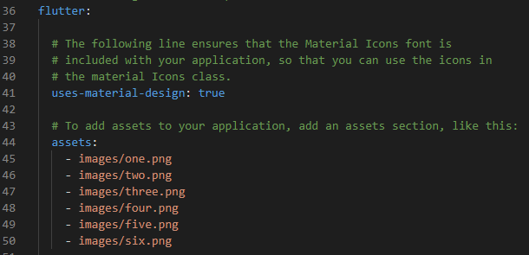
2. Edit pubspec.yaml
1. Edit pubspec.yaml and add the list of images on the assets
Note: Be careful of the indentation

Slide 13
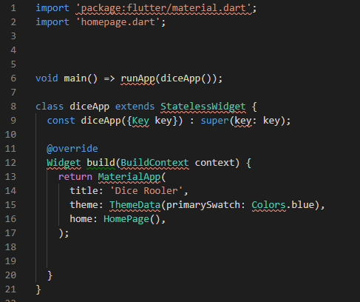
3. Import library and create main() , diceApp stateless widget (main.dart)

Slide 14
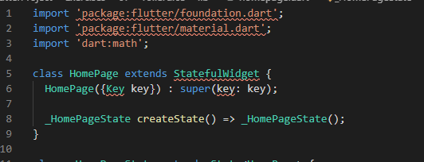
4. Create the HomePage stateful widget (homepage.dart)
Import the following library
material.dart
dart:math
Create the stateful widget

Slide 15
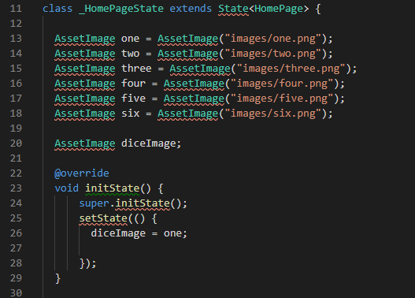
5. Create the _HomePage state (homepage.dart)

Slide 16
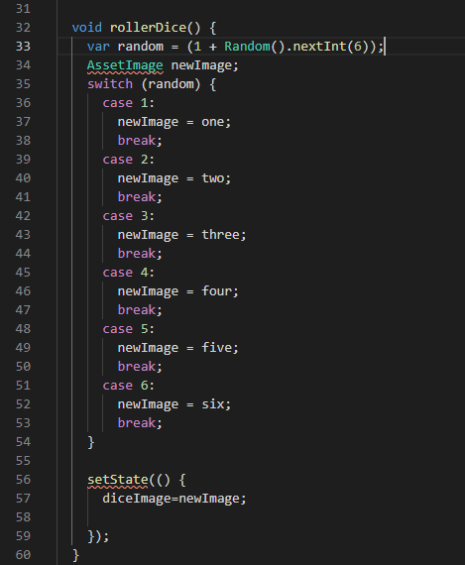
6. Create the _HomePage state (homepage.dart) cont’d …

Slide 17
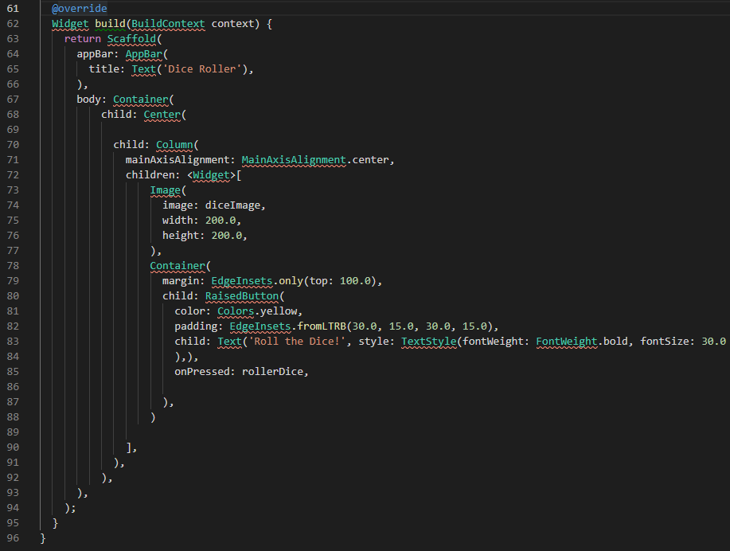
7. Create the _HomePage state (homepage.dart) cont’d …

Slide 18
Activity Challenge
Modify the roller dice app, adding another dice when the button roll dice is clicked.
Show the total value of the two dice in a text
Change the launcher icon of the Dice Roller App

Slide 19
Dice Roller Code
main.dart
homepage.dart

Slide 20

Using Android Studio for Flutter Dev

Slide 21
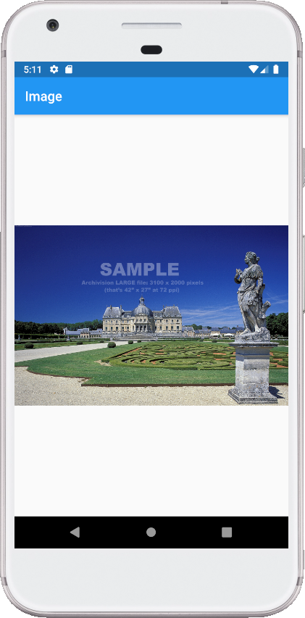
LoadingImage App
Create from an that will load an image from an Asset folder
Use a placeholder image while the image is being loaded from the internet
Use Material Library
This is a widget used to show an image. When displaying an image, you specify the image source in the constructor:
image provider
asset,
network,
file,
memory

Slide 22
1. Get Loading Image
Download: https://digitalsynopsis.com/wp-content/uploads/2016/06/loading-animations-preloader-gifs-ui-ux-effects-10.gif
Create new folder ‘assets’ in your project.
Rename image file to ‘loading.gif’.
Copy image file into ‘assets’ folder in your project.

Slide 23
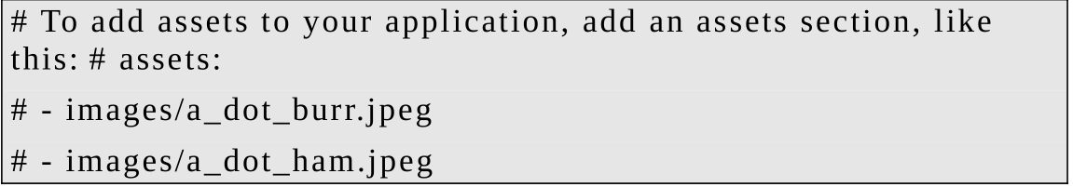
2. Include the Loading Image in Your Project as an Asset
Edit the pubspec.yaml file and change the lines below from:
To

Slide 24

3. Import Library and create main()

Slide 25
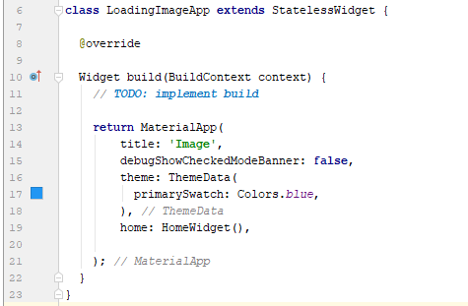
4. Create the LoadingImageApp stateless widget

Slide 26
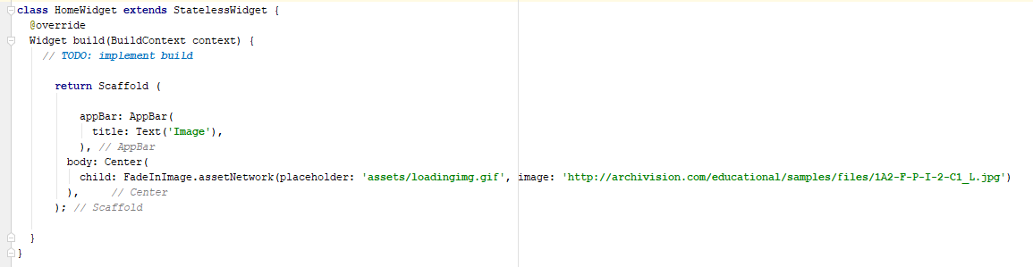
4. Create the HomeWidget stateless widget
Link for the image: http://archivision.com/educational/samples/files/1A2-F-P-I-2-C1_L.jpg

Slide 27
LoadingImage Code

Slide 28
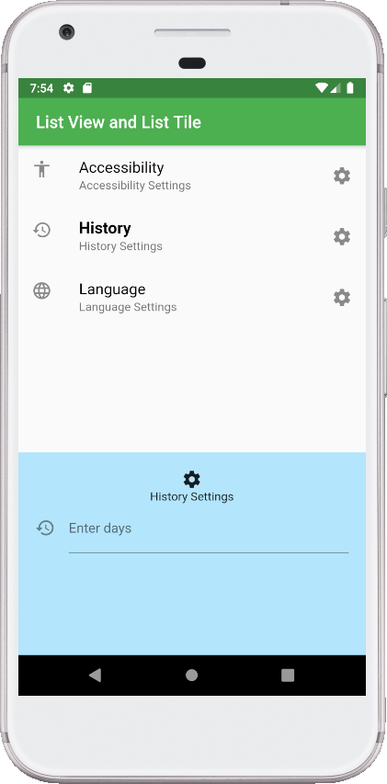
Working With ListView and ListTile
A list tile contains one to three lines of text optionally flanked by icons or other widgets, such as check boxes. So, you can have text in the middle and a widget on each side.
Many people combine ListViews and ListTiles together because ListTiles are great for building great-looking selection lists.

Slide 29

1. Import and create main()

Slide 30
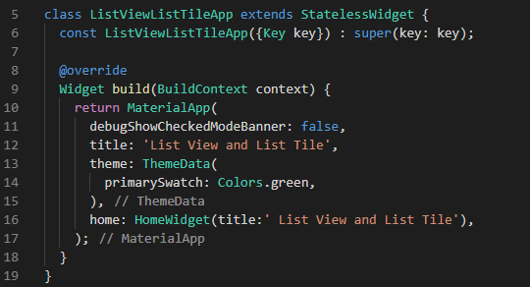
2. Create ListViewListTileApp stateless widget

Slide 31
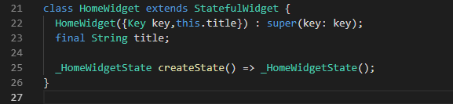
3. Create the HomeWidget stateful widgets

Slide 32
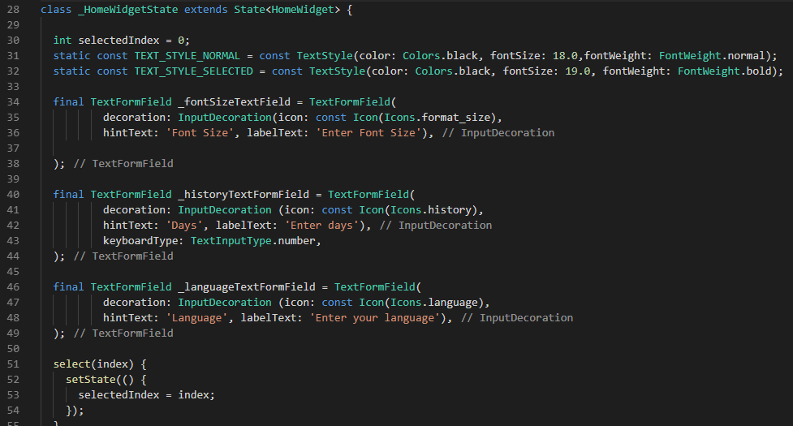
4. Create _HomeWidgetState state widget
Constant variable for text color
TextFormField for selected list
setState

Slide 33
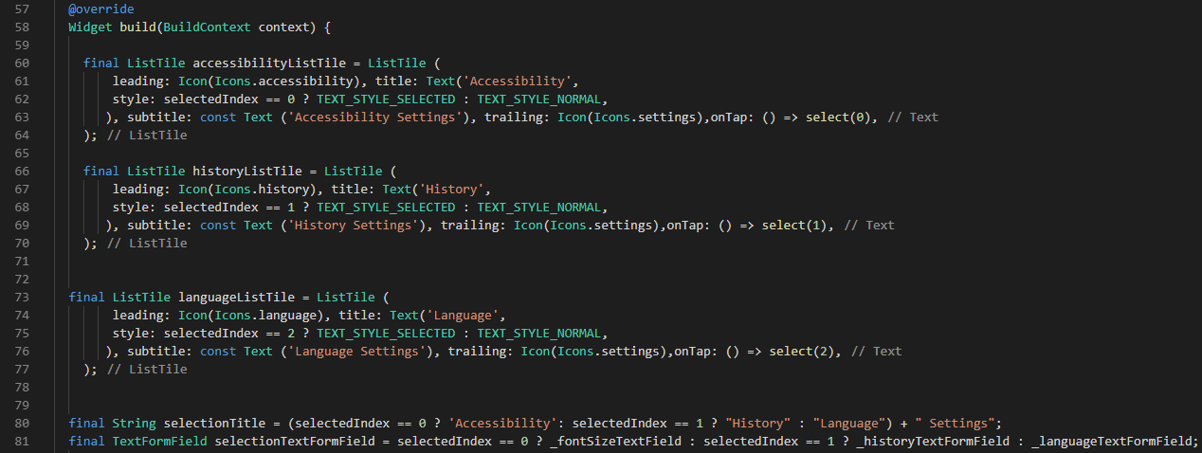
_HomeWidgetState state widget (cont’d)

Slide 34
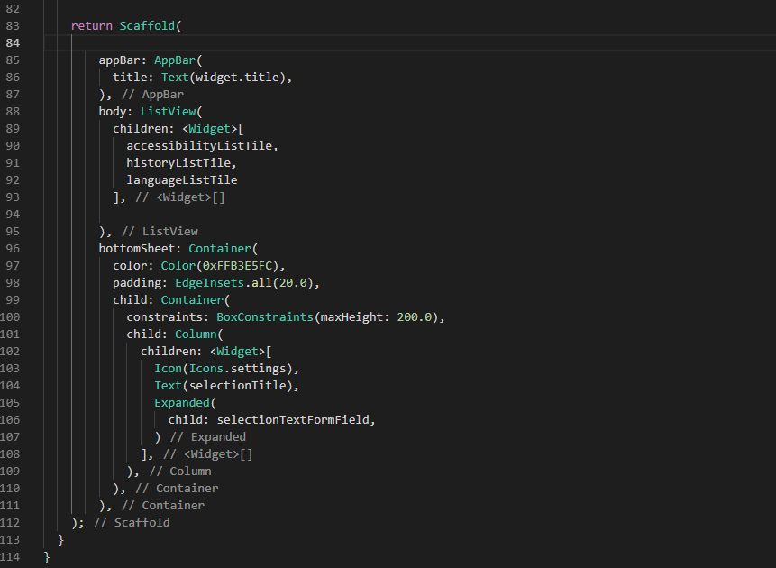
_HomeWidgetState state widget (cont’d)

Slide 35
ListViewListTile Code

Slide 36
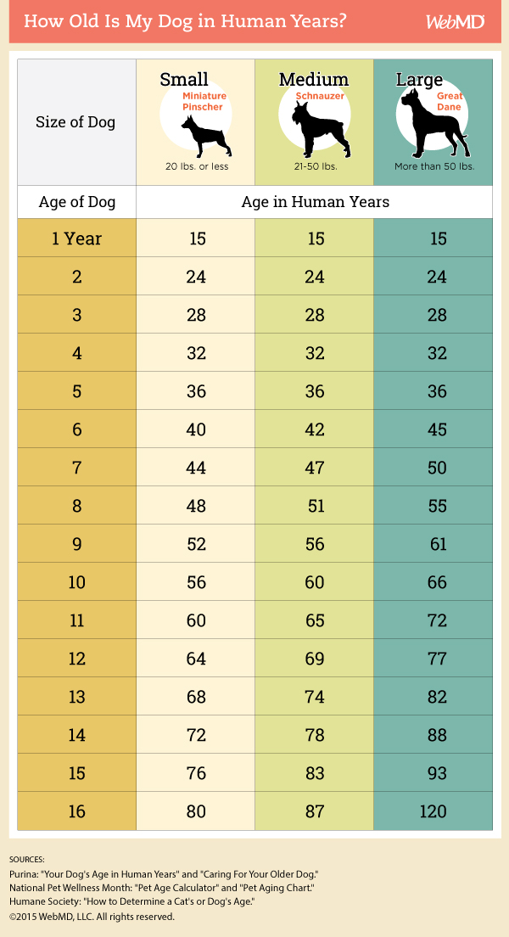
Workshop Challenge
Create an app that computes Dog age in Human years
https://pets.webmd.com/dogs/how-to-calculate-your-dogs-age

Slide 37
Building Release APK
Inside the app folder type
flutter clean, then
flutter build apk
The release APK for your app is created at <app dir>/build/app/outputs/apk/release/

Slide 38
Thank You Very Much!!!

